Slide 1

SEARCH ENGINE Topic : Evaluating Search Engine
By
161FA04394

Slide 2
Contents...
Why evaluate?
The evaluation corpus
Logging
Effectiveness Metrics
Recall and Precision
Averaging and Interpolation
Focusing on the top documents
Using Preferences

Slide 3
Why evaluate?
Evaluation is the key to making progress in building better search engines. It is also essential to understanding whether a SearchEngine is being used eﬀectively in a specific application.
One of the primary distinctions made in the evaluation of search engines is between eﬀectiveness and eﬃciency.
Eﬀectiveness, loosely speaking, measures the ability of the searchengine to find the right information.
Eﬃciency measures how quickly this is done.
In this environment, eﬀectiveness and eﬃciency will be aﬀected by many factors,such as the interface used to display search results and query refinement techniques, such as query suggestion and relevance feedback.
.The retrieval and indexing techniques in a searchengine have many parameters that can be adjusted to optimize performance, both in terms of eﬀectiveness and eﬃciency.

Slide 4
Evaluation corpus
A textcorpus is a large amount of text, usually in the form of many documents, that is used for statistical analysis of various kinds.
The test collection, or evaluation corpus, in information retrieval is unique in that the queries and relevance judgments for a particular search task are gathered in addition to the documents.
Test collections have changed over the years to reflect the changes in data and user communities for typical search applications.

Slide 5
The following three test collections were created at intervals of about 10 years, starting in the1980s:
CACM: Titles and abstracts from the Communications of the ACM from 1958–1979.Queries and relevance judgments generated by computer scientists.
AP: Associated Press newswire documents from 1988–1990 (from TREC disks1–3).Queries are the title fields fromTRECtopics51–150.Topics and relevance judgments generated by government information analysts.
GOV2: Web pages crawled from websites in the .gov domain during early 2004.Queries are the title fields fromTRECtopics701–850.Topics and relevance judgments generated by government analysts.

Slide 6
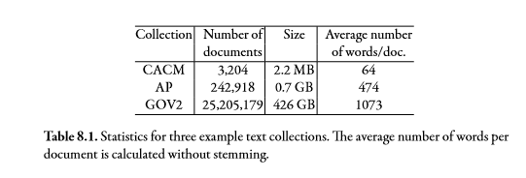

Slide 7
TREC topics contain three fields indicated by the tags.
The title field is supposed to be a short query, more typical of a web application.
The description field is a longer version of the query, which as this example shows, can sometimes be more precise than the short query.
The narrative field describes the criteria for relevance, which is used by the people doing relevance judgments to increase consistency, and should not be considered as a query.

Slide 8
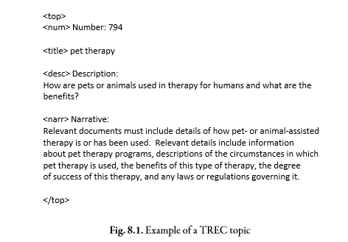

Slide 9
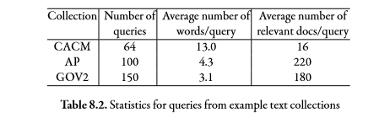
Most recent TREC evaluations have focused on using the title field of the topic as the query, and our statistics in Table8.2 are based on that field.

Slide 10
For most applications, it is generally easier for people to decide between at least three levels of relevance: definitely relevant, definitely not relevant, and possibly relevant.
These can be converted into binary judgments by assigning the “possibly relevant” level to either one of the other levels, if that is required for an eﬀectiveness measure. Some applications and eﬀectiveness measures, however, may support more than three levels of relevance.
For example, actions such as clicking on a document in a result list, moving it to a folder, or sending it to a printer may indicate that it is relevant.

Slide 11
Logging
Query logs that capture user interactions with a search engine have become an extremely important resource for web search engine development.
From an evaluation perspective, these logs provide large amounts of data showing how users browse the results that a search engine provides for a query.
Maintaining the privacy of the users is particularly an issue when query logs are shared, distributed for research, or used to construct user profiles.

Slide 12
A typical querylog will contain the following data for each query:
User identifier or user session identifier :This can be obtained in a number of ways . If a user logs on to a service, uses a search tool bar, or even allows cookies, this information allows the search engine to identify the user. A session is a series of queries submitted to a search engine over a limited amount of time.
In some circumstances, it may be possible to identify a user only in the context of a session.
Queryterms :The query is stored exactly as the user entered it.
List of URL’s of results : their ranks on the result list, and whether they were clicked on.
Timestamp(s):The timestamp records the time that the query was submitted.
Additional timestamps may also record the times that specific results were clicked on.

Slide 13
Two of the best predictors are:
Page dwell time: The page dwell time is the amount of time the user spends on a clicked result, measured from the initial click to the time when the usercomes.
Search exit action: The search exit action is the way the user exits the search application, such as entering another URL, closing the browser window, or timing out.

Slide 14
The bias in clickthrough data is addressed by “strategies,” or policies that generate preferences.
These strategies are based on observations of user behavior and verified by experiments.
One strategy that is known as Skip Above and Skip Next. This strategy assumes that given a set of results for a query and a clicked result at rank position p, all unclicked results ranked above p are predicted to be less relevant than the result at p. In addition, unclicked results immediately following a clicked result are less relevant than the clicked result. For example, given a result list of ranked documents together with click data as follows

Slide 15
d1
d2
d3 (clicked)
d4,
This strategy will generate the following preferences:
d3 > d2
d3 > d1
d3 > d4
Since preferences are generated only when higher-ranked documents are ignored, a major source of bias is removed.
The“Skip”strategy uses the clickthrough patterns of individual users to generate preferences. This data can be noisy and inconsistent because of the variability in users’ behavior

Slide 16
Specifically, click distribution information can be used to identify clicks that have a higher frequency than would be expected based on typical click patterns.
These clicks have been shown to correlate well with relevance judgments. For a given query, we can use all the instances of that query in the log to compute the observed click frequency O(d , p) for the result d in rank position p.
We can also compute the expected click frequency E(p) at rank p by averaging across all queries. The click deviation CD(d , p) for a result d in position p is computed as:
CD(d,p) = O(d,p)−E(p)
We can then use the value of CD(d,p) to “filter” clicks and provide more reliable click information to the Skip strategy.

Slide 17
Effectiveness Metrics
Recall: how well the search engine is doing to find all the relevant documents.
Precision: how well the search engine i doing to reject all non-relevant documents.
So here for a given query some documents can be retrieved and some are non-retrieved.
Let us consider
A is the relevant set of documents for the query
A’is the non-relevant set
B is the set of retrieved documents
B’ is the set of documents that are not retrieved.
The operator ∩ gives the intersection of two sets.For example, A∩B is the set of documents that are both relevant and retrieved.

Slide 18


Recall =
Precision =
|A|- size of A
|B| -size of B
There are 2 types of errors that are made in predicting /retrieval of the documents.
1.False Positive: a non-relevant document is retrieved.
2.False Negative:a non-relevant document is not retrieved.
Example: recall
But precision is not related to either of the two.

Slide 19

Another Measures
1. Fallout: proportion of non-relevant documents that are retrieved , is related to the false positive errors.
Fallout = |A’∩B| / |A’|
2. F-measure:
It s an eﬀectiveness measure based on recall and precision that is used for evaluating classification performance and also in some search applications. It has the advantage of summarizing eﬀectiveness in a single number.
It is defined as the harmonic mean of recall and precision, which is:
Interpolation: It refers to any technique for calculating a new point between two existing datapoints.

Slide 20
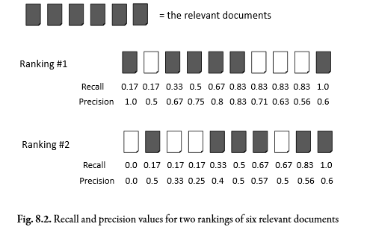

Slide 21
3. Average Precision:
For the first ranking in Figure8.2, the average precision is calculated as:
(1.0 + 0.67 + 0.75 + 0.8 + 0.83 + 0.6)/6 = 0.78
For the second ranking, it is:
(0.5 + 0.4 + 0.5 + 0.57 + 0.56 + 0.6)/6 = 0.52
Advantages in performing Averaging the precision values:
It is a single number that is based on the ranking of all the relevant documents, but the value depends heavily on the highly ranked relevant documents.
This means it is an appropriate measure for evaluating the task of finding as many relevant documents as possible while still reflecting the intuition that the top-ranked documents are the most important.

Slide 22
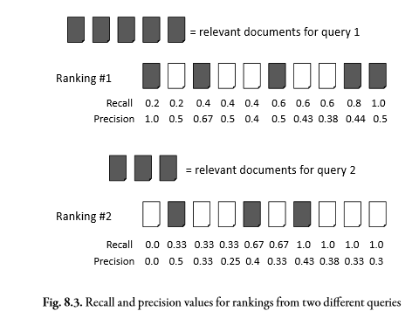
2. Averaging and Interpolation
Given that the average precision provides a number for each ranking, the simplest way to summarize the eﬀectiveness of rankings from multiple queries would be to average these numbers. This eﬀectiveness measure, mean average precision or MAP.

Slide 23
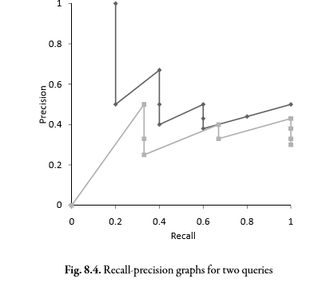
For the example in Figure8.3, the mean average precision is calculated as follows:
averageprecisionquery1= (1.0 + 0.67 + 0.5 + 0.44 + 0.5)/5 = 0.62
averageprecisionquery2= (0.5 + 0.4 + 0.43)/3 = 0.4
meanaverageprecision= (0.62 + 0.44)/2 = 0.53

Slide 24
3.Focusing on top documents
The mean reciprocal rank(MRR) is the average of the reciprocal ranks over a set of queries.
For example, if the top five documents retrieved for a query were dn,dr,dn,dn,dn, where dn is a non-relevant document and dr is a relevant document, the reciprocal rank would be 1/2 = 0.5. Even if more relevant documents had been retrieved, as in the ranking dn,dr,dn,dr,dn, the reciprocal rank would still be 0.5.
The reciprocal rank is very sensitive to the rankposition. It falls from 1.0 to 0.5 from rank 1 to 2, and the ranking dn,dn,dn,dn,dr would have a reciprocal rank of 1/5 = 0.2.
The MRR for these two rankings would be (0.5 + 0.2)/2 = 0.35

Slide 25


4.Using Preferences
Preferences are used for training ranking algorithms
1.Kendall tau Coefficient:
P- no. of preferences that agree
Q-no. Of preferences that disagree
KTC =
2.Binary Preferences(BPREF): Robust with partial information to give similar results to recall-precision measures such as MAP:
BPREF =

